Slide 1
Modernizing Our Document Storage: A Foundation for the Future
Session 58 Document Storage
Notes:
This presentation focuses on the critical need to upgrade and improve the ITS document storage system. It begins by examining the current challenges, including inefficiencies in document management, storage limitations, and security vulnerabilities.
The presentation explores modern solutions designed to address these issues, such as cloud-based platforms, document management systems, and advanced security features to ensure compliance and data integrity. Key benefits, scalability and cost-effectiveness.
Finally, a proposed roadmap for implementing an upgraded ITS storage system is presented, emphasizing phased deployment.

Slide 2
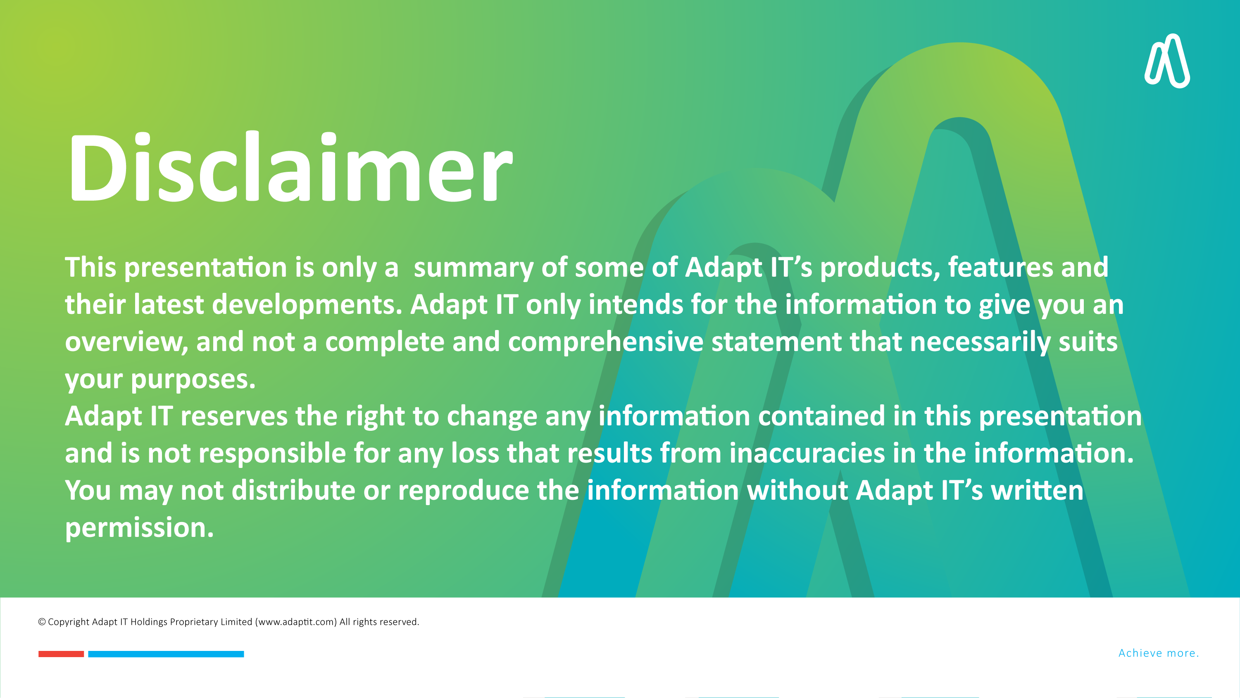
DISCLAIMER
This presentation is only a summary of some of Adapt IT’s products, features and their latest developments. Adapt IT only intends for the information to give you an overview, and not a complete and comprehensive statement that necessarily suits your purposes.
Adapt IT reserves the right to change any information contained in this presentation and is not responsible for any loss that results from inaccuracies in the information. You may not distribute or reproduce the information without Adapt IT’s written permission.

Slide 3

DISCLAIMER
This presentation is only a summary of some of Adapt IT’s products, features and their latest developments. Adapt IT only intends for the information to give you an overview, and not a complete and comprehensive statement that necessarily suits your purposes.
Adapt IT reserves the right to change any information contained in this presentation and is not responsible for any loss that results from inaccuracies in the information. You may not distribute or reproduce the information without Adapt IT’s written permission.

Slide 4


Data Management
Notes:
University of Zululand (UZ) Admissions Fraud (2017): Reports surfaced of a syndicate operating at UZ that was selling fake admission letters and student registration documents. Aspiring students were allegedly paying large sums of money to these fraudsters, who promised them guaranteed admission to the university. The university authorities uncovered the scam and arrested several individuals involved in the syndicate. This incident exposed the criminal networks that prey on desperate students seeking access to higher education.
Vaal University of Technology (VUT) Fraudulent Registrations (2020): Following a surge in student registrations, VUT discovered that a significant number of applicants had submitted fraudulent documents. The university's internal investigation revealed that some students had falsified their academic records, while others had used fake proof of residence documents. VUT took swift action to cancel the registrations of the implicated students and tightened its document verification procedures. This case underscored the importance of robust document verification measures to safeguard the integrity of university admissions processes.
The most recent case involves the University of Johannesburg (UJ), where 50 students were expelled in July 2024 for submitting fraudulent documentation. The students were found guilty of submitting fake matric certificates, fraudulent medical certificates, and engaging in plagiarism1. This crackdown highlights UJ's commitment to maintaining academic integrity and upholding stringent ethical standards.
Imagine there is a forensic investigation into fraudulent documentation at your university. Your are instructed extract all documentation related to the case as evidence in the investigation. You logs into the document storage system, only to find a slow, outdated interface that takes forever to load. After multiple failed search attempts due you find documents.
An universities have several responsibilities when it comes to verifying and keeping student documentation. These responsibilities are guided by various policies and legislation, including the
National Archives and Records Service Act (No 43 of 1996)
Promotion of Access to Information Act (No 2 of 2000)
Protection of Personal Information Act (No 4 of 2013).
Verification of Documentation:
Universities must verify the authenticity of all student documentation, including academic records, identification documents, and other relevant paperwork. This ensures that only legitimate students are admitted and that their records are accurate.
Record Keeping:
Universities are required to maintain accurate and complete records of all students. This includes personal information, academic records, attendance, and any other relevant documentation1.
Retention and Disposal:
Universities must follow specific retention schedules for student records, ensuring that documents are kept for the required period and disposed of securely when no longer needed.
Confidentiality and Security:
Universities must ensure that student records are kept confidential and secure, protecting them from unauthorized access, theft, or damage.
Compliance with Legislation:
Universities must comply with relevant legislation and standards, such as the National Archives and Records Service Act, the Promotion of Access to Information Act, and the Protection of Personal Information Act.
Accessibility:
Universities must ensure that student records are accessible to authorized personnel and students themselves, as needed, while maintaining confidentiality and security.
UJ expels 50 students for fake matric certificates, sick notes and misconduct
18 July 2024 - 15:25
https://www.timeslive.co.za/news/south-africa/2024-07-18-uj-expels-50-students-for-fake-matric-certificates-sick-notes-and-misconduct/

Slide 5

Document Storage Overview

Slide 6

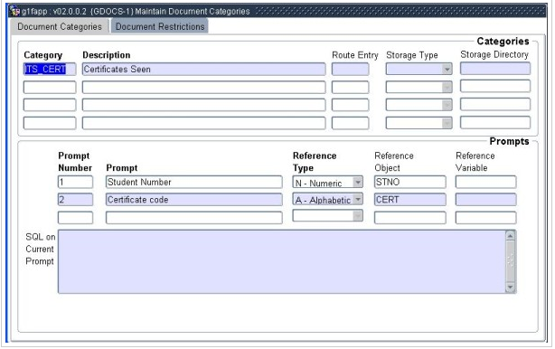
Document Category & Reference Fields

Slide 7

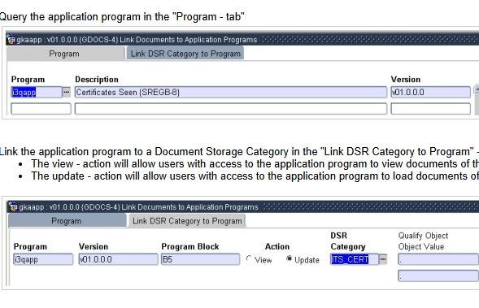
Link the Document Category to the Application

Slide 8
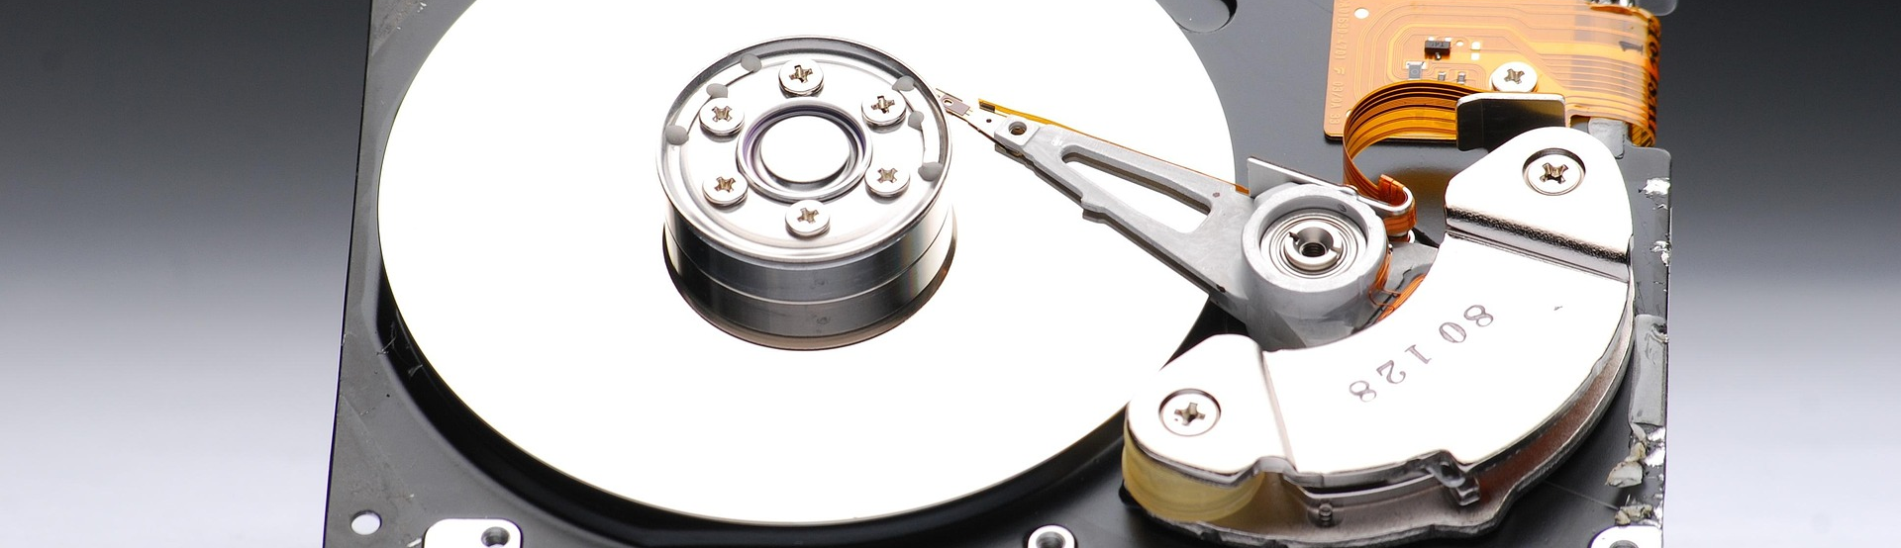
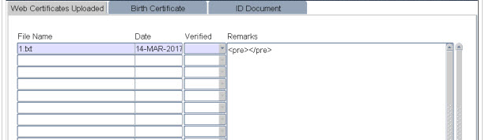
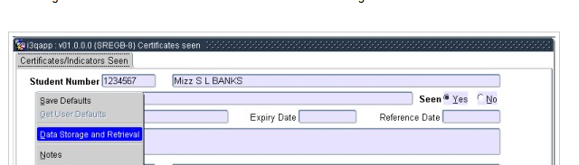
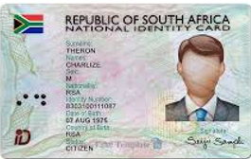
Storing Documents

Slide 9
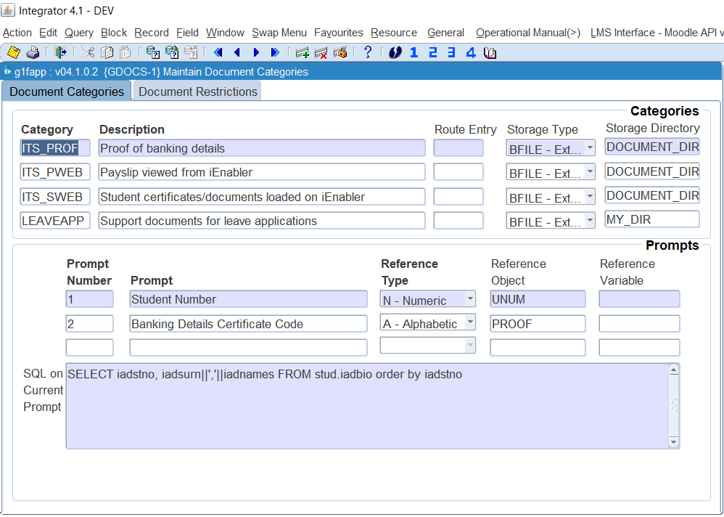
Storing Documents
Blank - documents are stored in database.
BFILE - documents are stored in a directory on file system.
HTTPURI - documents are stored at the specified URI / URL provided that the URL is accessible.
Notes:
Note that for this storage type there is an upper limit of 4 GB per document
This storage type may have a significant effect on the increase in database size, depending on the size and volume of documents to be stored.
If set to "BFILE", documents of the category will be stored in a directory directly accessible for read/write operations to the back-end database of the Integrator System through an "Oracle Directory Object".
If set to "HTTPURI", documents of the category will be stored at the specified URI / URL provided that the URL is accessible for read/write operations to the back-end database of the Integrator System. If this method is used and a default URL is entered in the SQL block all entries pointing to this URL can automatically be viewed without saving the URL/document first.
If documents for a specific category exists in the same place, the actual URL must be defined in the SQL block of the first prompt.
If more than one prompt exists to identify the document which will be part of the URL then the default URL should be setup accordingly.
Please note this can be overwritten with a new URL when the document is uploaded, and the URL differs.
Default part of URL where documents are stored: www.google.co.za/webph?q
Prompt that forms part of the URL to identify the document - Student number: = [[1]]

Slide 10
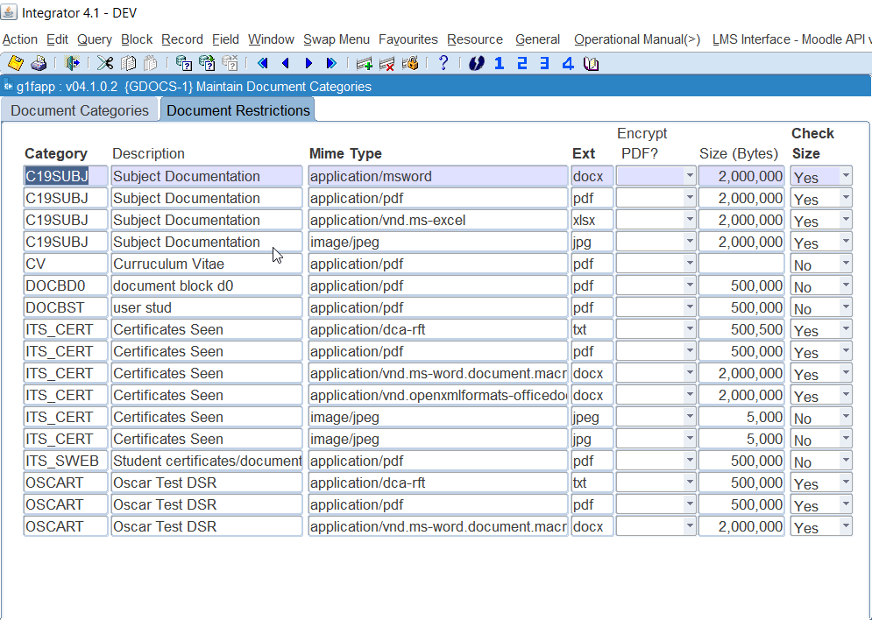

Document Restrictions
Notes:
A MIME type (Multipurpose Internet Mail Extensions type) is a standard way of indicating the nature and format of a file or data being transmitted over the internet.
It is used by web browsers, email clients, and other applications to properly handle different types of content.
Web Browsers: To determine how to handle different file types (e.g., displaying an image or prompting a download).
Email: To define file attachments and specify text encoding.
APIs: To indicate content types in HTTP headers (Content-Type and Accept).
File Systems: Some operating systems use MIME types to identify file types. The extension of files of this type, this must be entered without the "." eg. pdf or txt.
If set to "Y"es, the system will not allow files of the Mime Type that is larger than the specified size to be loaded for this Document Category.

Slide 11

Document Storage Maintenance
Personnel Downloaded Documents
Dump DSR to file system
Delete Old DSR Documents
Maintain Bulk upload DSR Documents

Slide 12
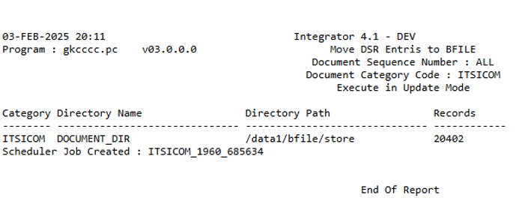
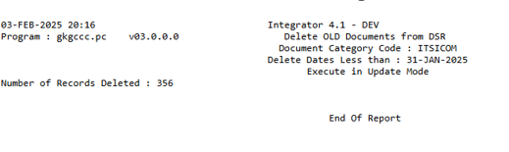
{GDOCSR- 1/2 /3/4}

Slide 13



Challenges and Pain Points

Slide 14

Challenges and Pain Points
Performance Issues
Increased Database Size
Backup and Restore Complexity
Scalability Challenges
Network Overhead
Locking and Concurrency Issues
Limited Flexibility
Notes:
Storing images as BLOBs (Binary Large Objects) or CLOBs (Character Large Objects) in a database has several drawbacks:
1. Performance Issues
Database Load: Storing images directly in the database increases its size significantly, which can slow down queries and backups.
Retrieval Speed: Fetching images from a database is generally slower compared to retrieving them from a file system or cloud storage.
2. Increased Database Size
Large image files can cause the database to grow rapidly, leading to increased storage costs and more complex maintenance.
3. Backup and Restore Complexity
Database Backups Become Larger and Slower: Since images are stored as BLOBs/CLOBs, backup operations take more time and require more storage.
Longer Recovery Times: Restoring a large database with images can be slow and impractical in a disaster recovery scenario.
4. Scalability Challenges
A database storing large amounts of images may struggle to scale, leading to performance degradation.
More RAM and CPU resources are needed to process queries involving large binary data.
5. Network Overhead
Querying images over the network may consume more bandwidth compared to serving them via a content delivery network (CDN) or dedicated storage like Amazon S3.
6. Locking and Concurrency Issues
Databases typically lock rows when updating them. Updating or replacing a BLOB may lock records for longer periods, blocking concurrent users from accessing the data.
7. Limited Flexibility
Moving a database with BLOB data to another system is harder compared to migrating images stored in a file system or cloud storage.
Some database engines impose size restrictions on BLOBs/CLOBs, limiting the size of images that can be stored.
When is Storing Images in a Database Acceptable?
If strong security and encryption are required.
When images are small and frequently accessed with related metadata.
For self-contained applications where external file storage is not feasible.
Better Alternative
Instead of storing images as BLOBs, a more efficient approach is:
Store images in a file system (local or cloud storage like AWS S3, Google Cloud Storage).
Store the image URL or path in the database for easy retrieval.
Would you like help evaluating storage options for your system?
Challenges and Pain Points Challenges and Pain Points

Slide 15

Modern Storage Options & Strategies

Slide 16





Image Storage - Best Pratice
Cloud
Image paths
Tiered storage
CDN
Encrypt , restrict
Use cloud storage (AWS S3, Azure Blob) or object storage for scalable and secure image storage.
Store image paths in a database instead of storing images as BLOBs.
Implement tiered storage (hot, warm, cold) for cost efficiency.
Use CDN for fast access and reduced network load.
Encrypt and restrict access to sensitive images.

Slide 17
Benefits of modernization:
Improved Performance
Enhanced Maintainability
Scalability
Improved Security
Better User Experience
Cost Savings
Notes:
Improved Performance: Faster retrieval times, more efficient search capabilities, and better system responsiveness.
Enhanced Maintainability: Easier updates, simplified administration, and reduced risk of system failure.
Scalability: Ability to handle future growth in data volume and user base.
Improved Security: Enhanced access controls, data encryption, and compliance with relevant regulations (e.g., GDPR, FERPA).
Better User Experience: Intuitive interface, mobile access, and integration with other systems.
Cost Savings: While there will be upfront costs, explain how long-term savings in maintenance, support, and increased productivity will justify the investment.

Slide 18


Summary

Slide 19

Summary
“We must all suffer one of two things: the pain of discipline or the pain of regret.“
(Jim Rohn)
Notes:
Jim Rohn, born Emanuel James Rohn on September 17, 1930, was an American entrepreneur, author, and motivational speaker. He is best known for his work in personal development and his influence on many successful entrepreneurs and motivational speakers, including Tony Robbins, Mark Victor Hansen, and Jack Canfield1.
Rohn's journey began on a farm in Caldwell, Idaho, and he later became a millionaire by age 30. After facing financial challenges, he rebuilt his success and continued to inspire others through his seminars and writings1. Some of his most popular works include "The Power of Ambition," "Take Charge of Your Life," and "The Day That Turns Your Life Around."
Would you like to know more about his teachings or any specific quotes?

Slide 20


Questions

